Slide 1
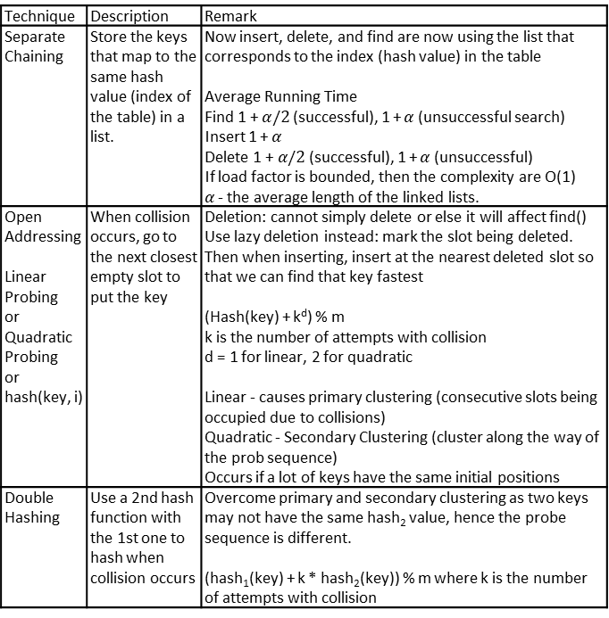
Selection Sort
Select the smallest element in the curr subarray (by finding it) and swap it with the first item in the currarray
Front sorted, swapped elements
Bubble Sort
“Bubble” the largest element to the end of the curr subarray by keep swapping it with its next element
Back sorted, unsorted part has same last element
Insertion Sort
Arrange poker cards: Take the first element you have now and insert it into the right position in the curr subarray in front of it.
Front part is sorted amongst itself, back untouched
Merge Sort
Keep dividing the array into part by part until you can’t divide it anymore and gradually merge the parts together
Divide the array into 2 parts, call merge sort on the left part and right part, and then merge them together
Sorted within half intervals
Quick Sort
Choose a pivot, partition the array by putting the elements smaller than the pivot to its left and elements greater than the pivot to its right, call quicksort again on the 2 subparts recursively.
Partitioned about pivot
Radix Sort
For number-wise radix sort, you create 10 groups (digit 0~9), put the numbers into one of the groups according to their digit at the curr k position, repeat this until you hit the first digit
Technique | Description | Remark
Separate Chaining | Store the keys that map to the same hash value (index of the table) in a list. | Now insert, delete, and find are now using the list that corresponds to the index (hash value) in the table Average Running Time Find 1 + $α/2$(successful), 1 + $α$ (unsuccessful search) Insert 1 + $α$ Delete 1 + $α/2$ (successful), 1 + $α$ (unsuccessful) If load factor is bounded, then the complexity are O(1) 𝛼 - the average length of the linked lists.
Open Addressing Linear Probing or Quadratic Probing or hash(key, i) | When collision occurs, go to the next closest empty slot to put the key | Deletion: cannot simply delete or else it will affect find() Use lazy deletion instead: mark the slot being deleted. Then when inserting, insert at the nearest deleted slot so that we can find that key fastest (Hash(key) + k^{d}) % m k is the number of attempts with collision d = 1 for linear, 2 for quadratic Linear - causes primary clustering (consecutive slots being occupied due to collisions) Quadratic - Secondary Clustering (cluster along the way of the prob sequence) Occurs if a lot of keys have the same initial positions
Double Hashing | Use a 2nd hash function with the 1st one to hash when collision occurs | Overcome primary and secondary clustering as two keys may not have the same hash₂ value, hence the probe sequence is different. (hash₁(key) + k * hash₂(key)) % m where k is the number of attempts with collision
Dijkstra PQ | V x insert | V x extract | E x decKey | Total
Array | 1 | V | 1 | O(V²)
AVL Tree | logV | logV | logV | O(ElogV)
d-way heap | dlog_{d}v | dlog_{d}V | log_{d}V | O(Elog_{E/V}V)
Fibo Heap | 1 | logV | 1 | O(E+VlogV)

Slide 2
Common Techniques - Sorting
Discrete sequential variable
Find an optimal point – binary search
Find kth value – quick select -> O(n) ave, O(n^2) worst
Find biggest/smallest k elements -> max/min heap
Sorting with tie-breakers
- Sort by tie-breakers, then use a stable sort
Need to compare elements – hashtable
Added benefit of un-nesting for loops
Comparing is expensive – hashtable stores value and fingerprint
1 hash for value, 1 hash for fingerprint
Choose larger range for fingerprint since it does not affect space
Nodes on graph that we need to visit
1 – SSSP from both src and dest to nodes
2 – clone graph, use nodes as bridge
Cost of edge traversal is multiplied, not times
Reweight each edge to log(w)
Sum and 2^(sum) for cost
Nearly sorted array
Insertion sort has best case O(n)
Bubble sort with flag can be easily tripped to O(n^2)
Sort where writing is expensive - selection sort max 2n writes
Time of O(nlogn) with quick sort of n/logn pivots first
Operation along class storing multiple variables
Store a sorted order by each variable - c x O(nlogn)
If it’s just 2 variables, usually can be achieved by sorting by 1
Sort into a specific ordering
Sort index instead
Common Techniques – Trees
Specialised way of weighting tree
Recursively formulate calculation of weights at each node
Calculate from root to leaves and back up via DFS
AVL Tree with 2 variables
Sort by one, store subtree’s min/max of other
In-order traversal of BST gives a sorted array
Need to know weight on each side of an edge
Recurse upwards via DFS, node stores weight of subtree
Figure out which side is child, take weight and total – weight
Post+Pre-order Traversal
Print node before and after traversing children
Children of x contained within bounds of x printed
Left child first, then right child
X, L, ….., L, R, ……, R, X
Common Techniques - Graphs
Modifying edge weights:
Max instead of min – negate weights
Multiply instead of sum – log weights
Looking for even/odd cycles
BFS, compare frontiers when hit visited node
MST with multiple, disconnected roots
Prim’s initialised with roots, or 1 parent node to roots
Graphs with special cases of “cost”
Is shortest path always in MST? – run MST algo
Positive weight cycles can exists – bellman ford
Bellman ford up to k hops
For k iteration, store relaxation result in a new array and update only at the end of each iteration
Must travel exactly x hop each time – matrix multiplication
Detecting cycles
1 – if positive weights, bellman ford
2 – DFS with additional recursive visited array
3 – Kahn with failure detection
Weight of all cycles on directed
- Floyd Warshall, for every pair (u,v) weight = d(u,v) + d(v,u)
Graph with odd and even steps
Copy to G and G’, edge from G to G’ is odd, vice versa
Graph where some nodes are “combined”
1 – Union to join nodes, vertexes are components
Good if components are big - O(E log V)
2 – Complete partite graph between components
Good if components are small - O(V + kE) where k is the size of biggest component
Graph where relations has an inequality
Incorporate triangle inequality to weigh edges
Datastuctures
Care only about min, max – heap
Sortable values – BST, skip-list
Many operations in logn time - AVL tree
Need to query with prefix – tries / radix tree
Sequential operations with O(1) lookup
Tree / list with hashtable with key of data and value = pointer to node
Constant and known size structure – array
High number of duplicates – hashtable
O(n) construction time – heap or hashtable
Duplicates can be ignored - hashtable

